Slide 1

Datamining the City Fall 2016
Ge Zhao, Jiaqi Sun, Tianyang Xie

Slide 2
2D to
3D
Abstract
Datamining the City Fall 2016
Ge Zhao, Jiaqi Sun, Tianyang Xie

Slide 3
Introduction Why?
Are you sure the dimension of the buildings?
Datamining the City Fall 2016
Ge Zhao, Jiaqi Sun, Tianyang Xie

Slide 4

Introduction Why?
Are you sure the dimension of the buildings?
HOW CAN I KNOW THAT ???
Datamining the City Fall 2016
Ge Zhao, Jiaqi Sun, Tianyang Xie

Slide 5
Introduction How to Use a Tape Measure to measure a Building
Datamining the City Fall 2016
Ge Zhao, Jiaqi Sun, Tianyang Xie

Slide 6
Hypothesis
Datamining the City Fall 2016
Ge Zhao, Jiaqi Sun, Tianyang Xie

Slide 7
Hypothesis
Datamining the City Fall 2016
Ge Zhao, Jiaqi Sun, Tianyang Xie

Slide 8
Hypothesis
Datamining the City Fall 2016
Ge Zhao, Jiaqi Sun, Tianyang Xie

Slide 9
Hypothesis
CNN
RNN
X1_Picture
X2_Points
Y_Edges
Datamining the City Fall 2016
Ge Zhao, Jiaqi Sun, Tianyang Xie

Slide 10


Methodology Data Collection
Datamining the City Fall 2016
Ge Zhao, Jiaqi Sun, Tianyang Xie

Slide 11
Methodology Data Collection
Datamining the City Fall 2016
Ge Zhao, Jiaqi Sun, Tianyang Xie

Slide 12
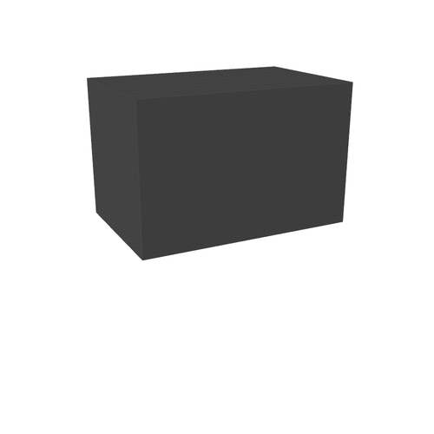
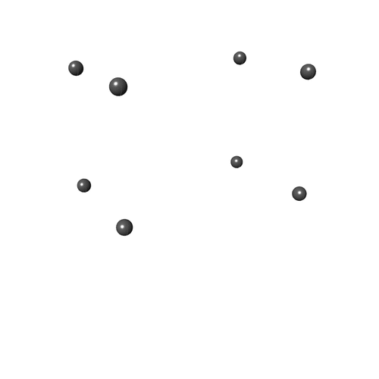


Methodology Data Collection
Datamining the City Fall 2016
Ge Zhao, Jiaqi Sun, Tianyang Xie

Slide 13
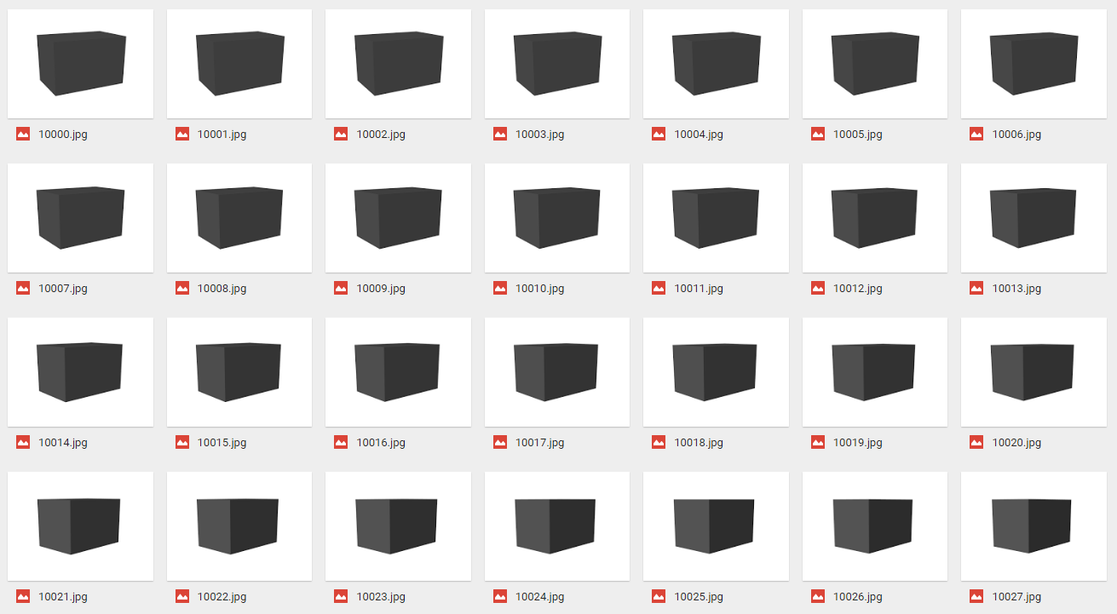
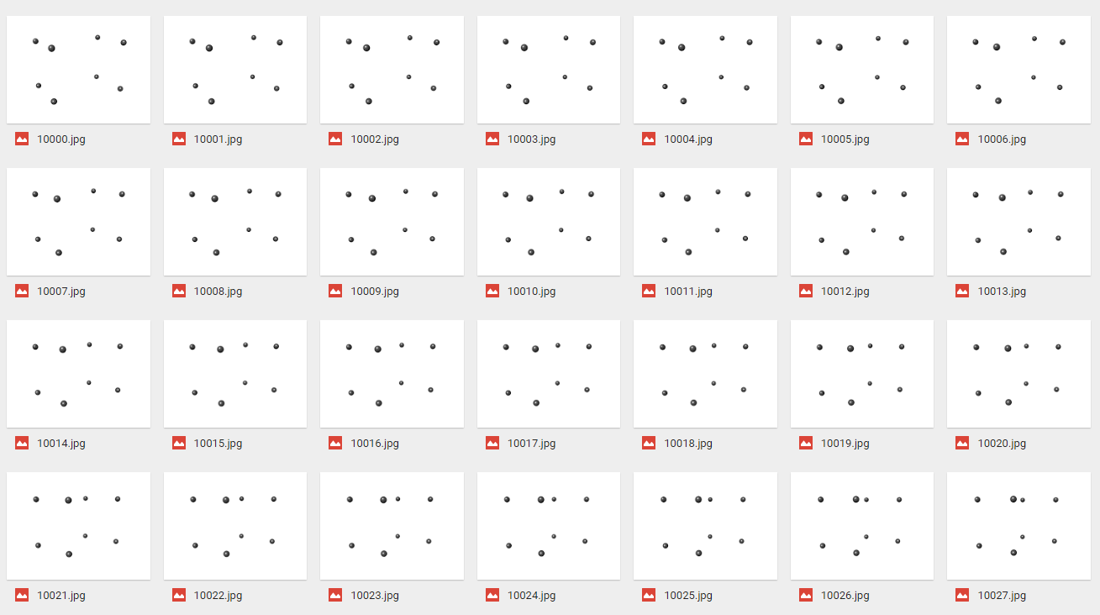
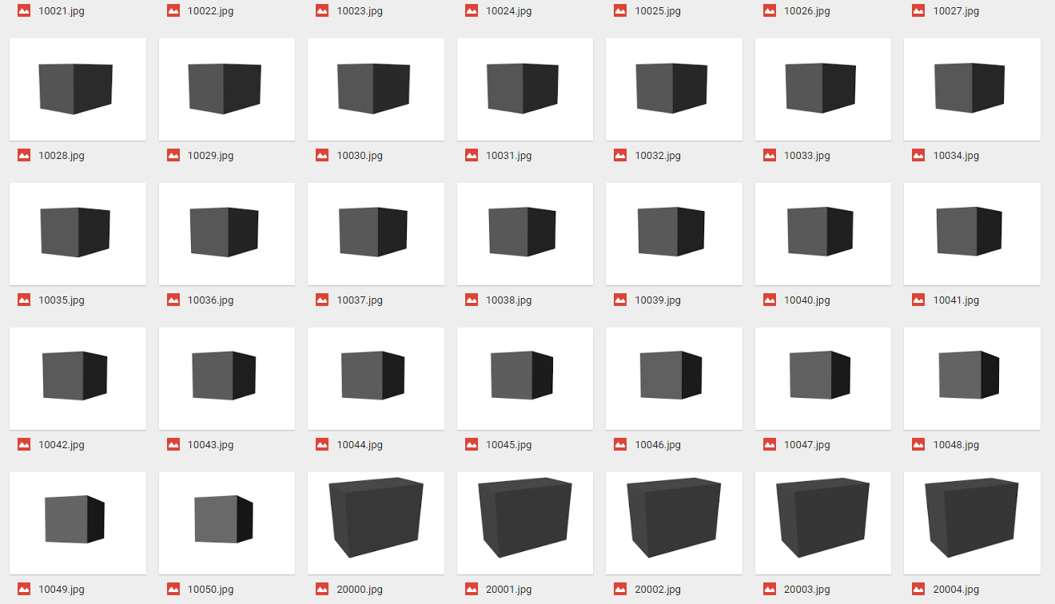
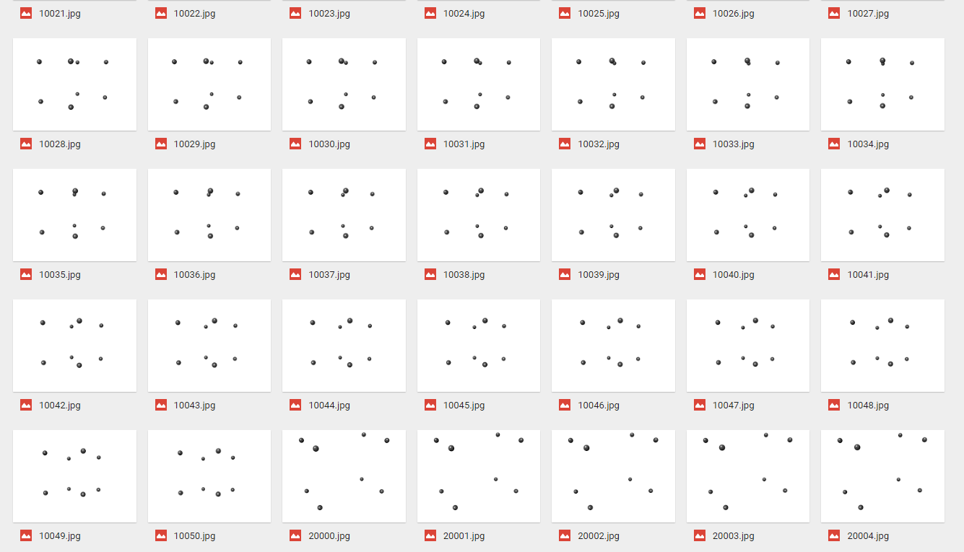
Methodology Data Collection
Datamining the City Fall 2016
Ge Zhao, Jiaqi Sun, Tianyang Xie

Slide 14
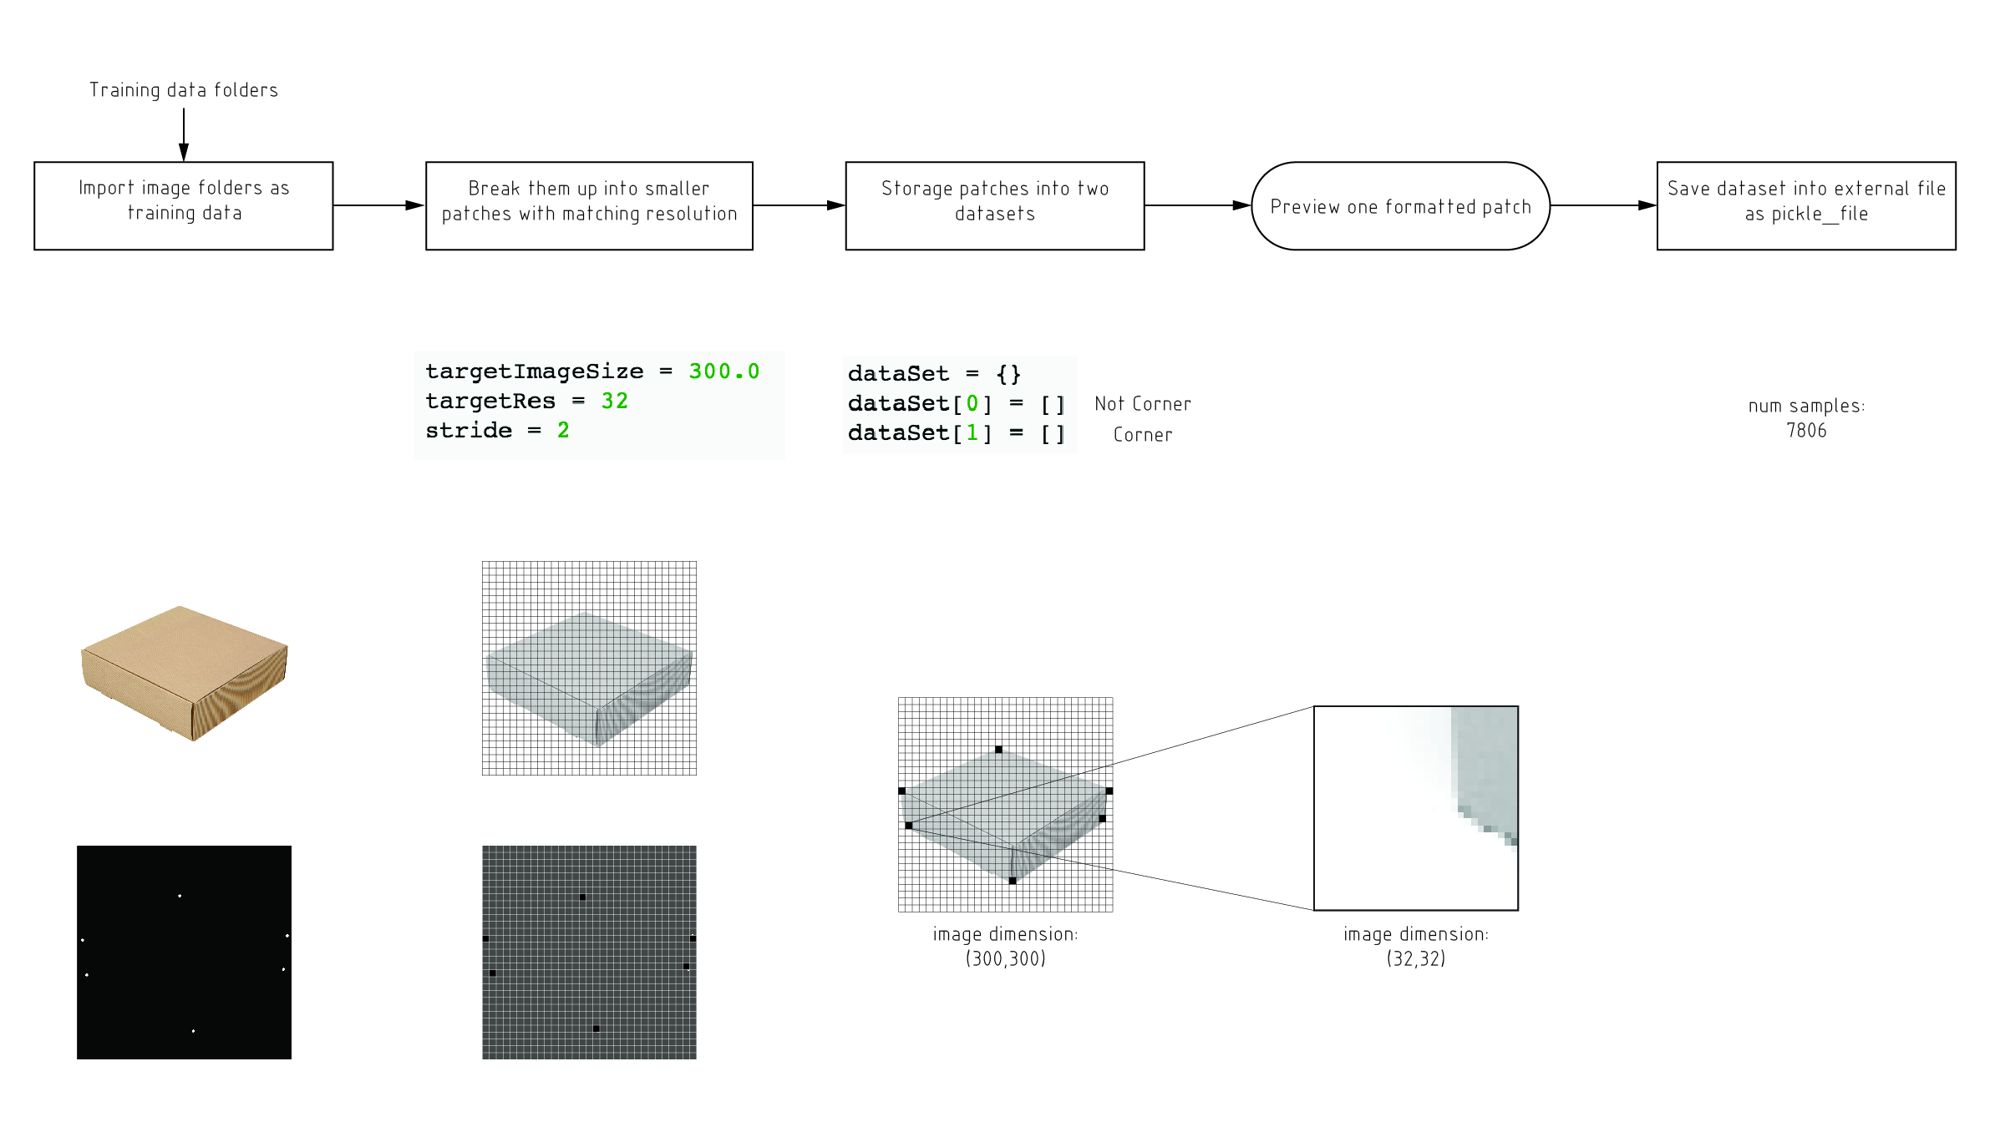
Methodology 01_Image Clip
Datamining the City Fall 2016
Ge Zhao, Jiaqi Sun, Tianyang Xie

Slide 15
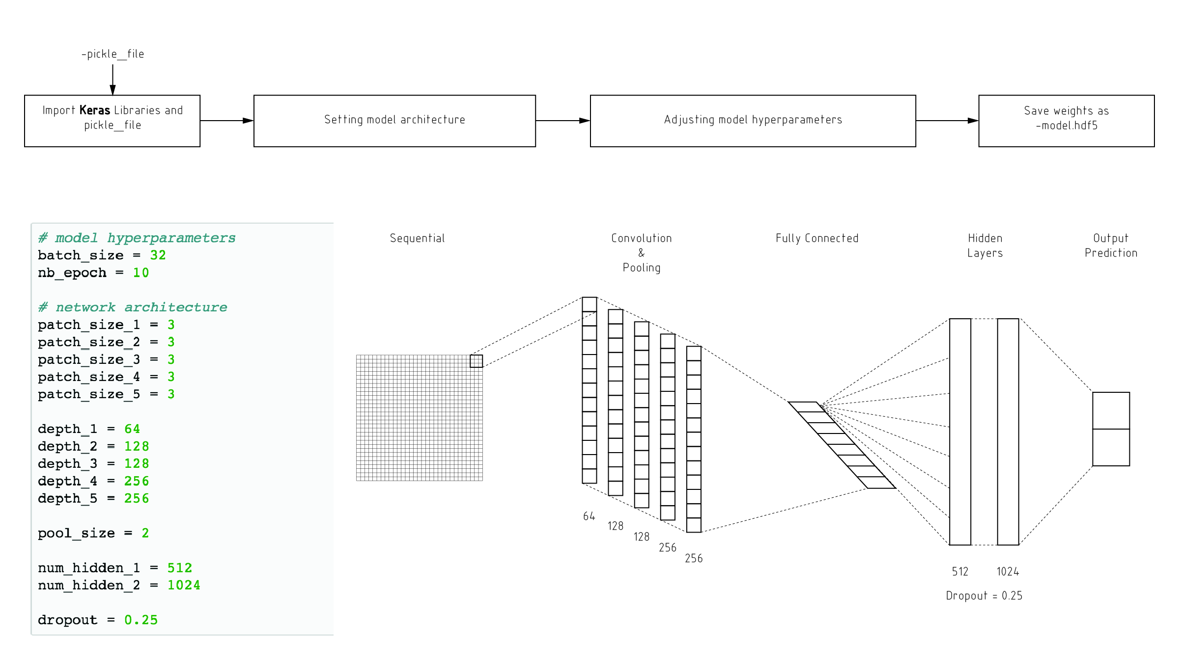
Methodology 02_Build Model
Datamining the City Fall 2016
Ge Zhao, Jiaqi Sun, Tianyang Xie

Slide 16
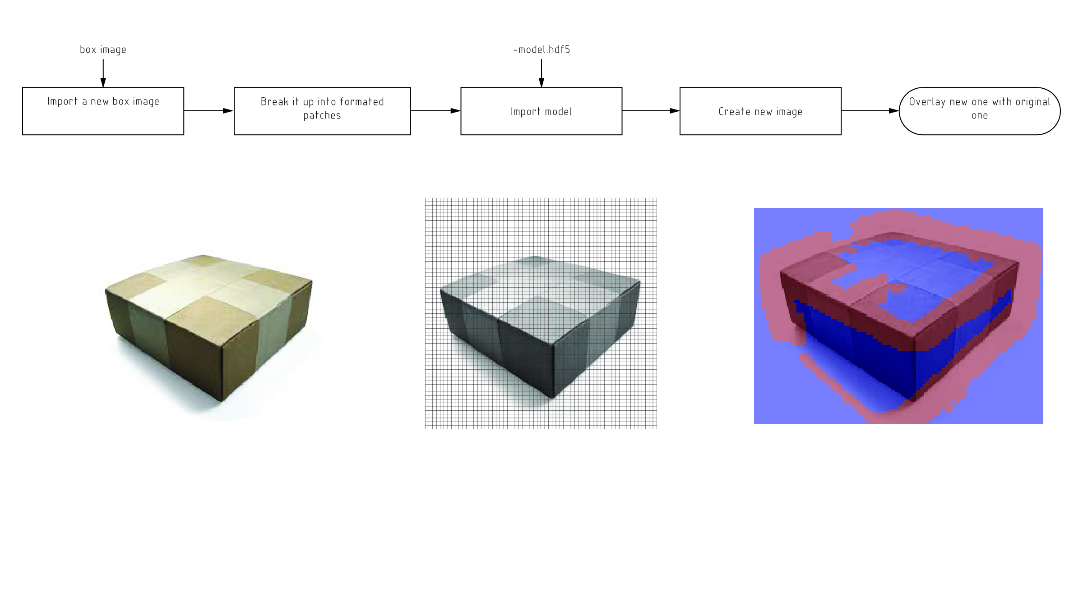
Methodology 03_Use Model
Datamining the City Fall 2016
Ge Zhao, Jiaqi Sun, Tianyang Xie

Slide 17

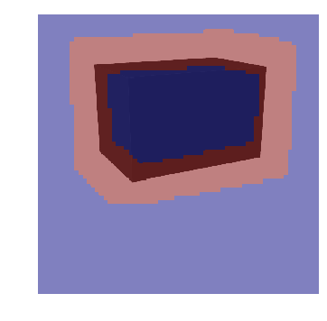
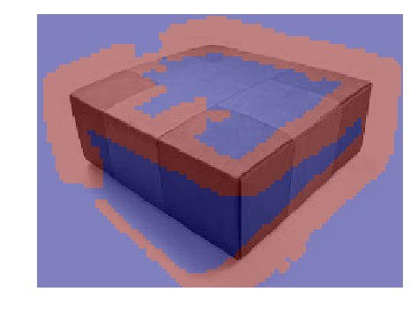

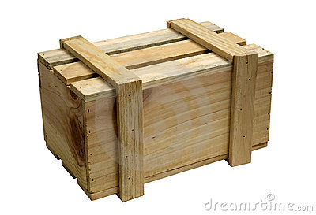

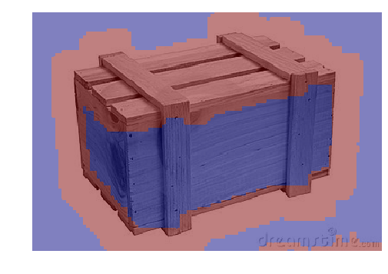
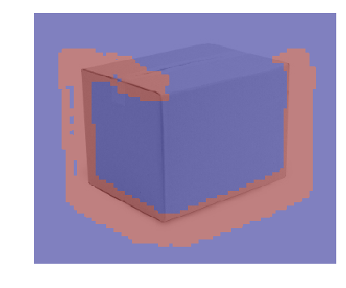
Methodology Shape_Identifying
Datamining the City Fall 2016
Ge Zhao, Jiaqi Sun, Tianyang Xie

Slide 18
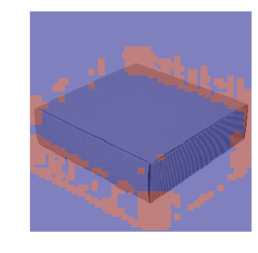
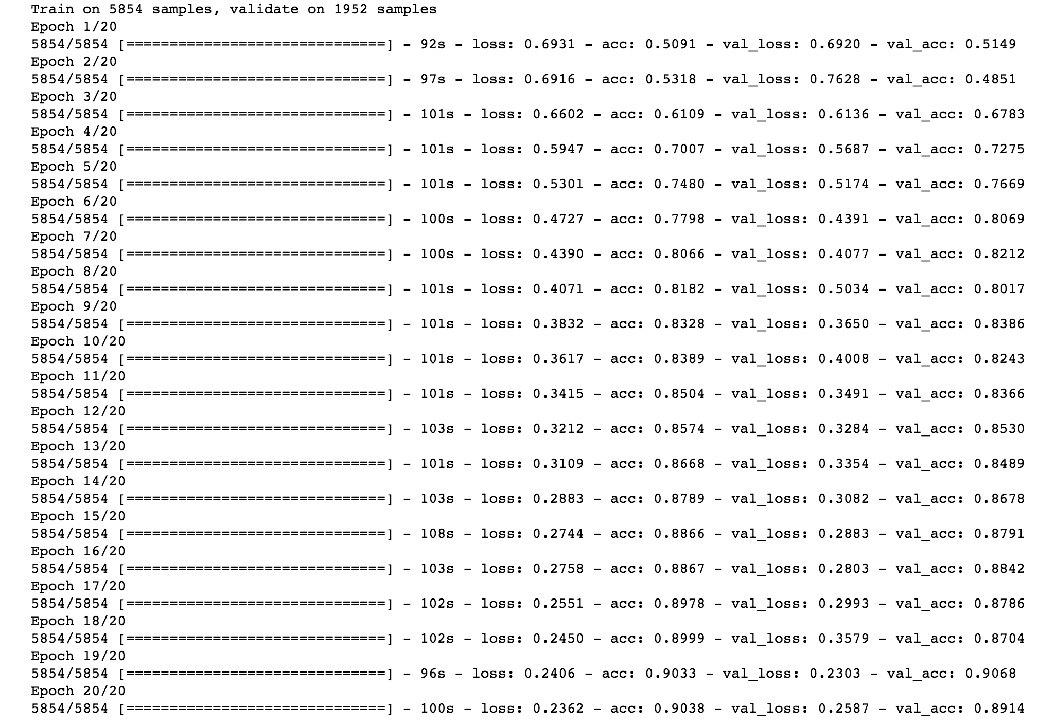
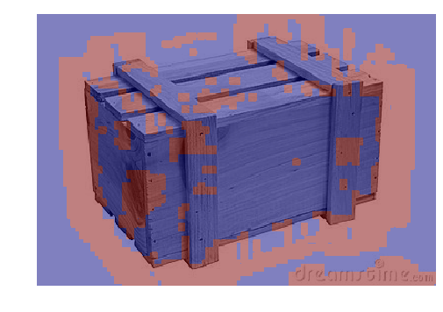
Methodology Shape_Identifying
Datamining the City Fall 2016
Ge Zhao, Jiaqi Sun, Tianyang Xie

Slide 19
Conceptual Experience_1
Datamining the City Fall 2016
Ge Zhao, Jiaqi Sun, Tianyang Xie

Slide 20
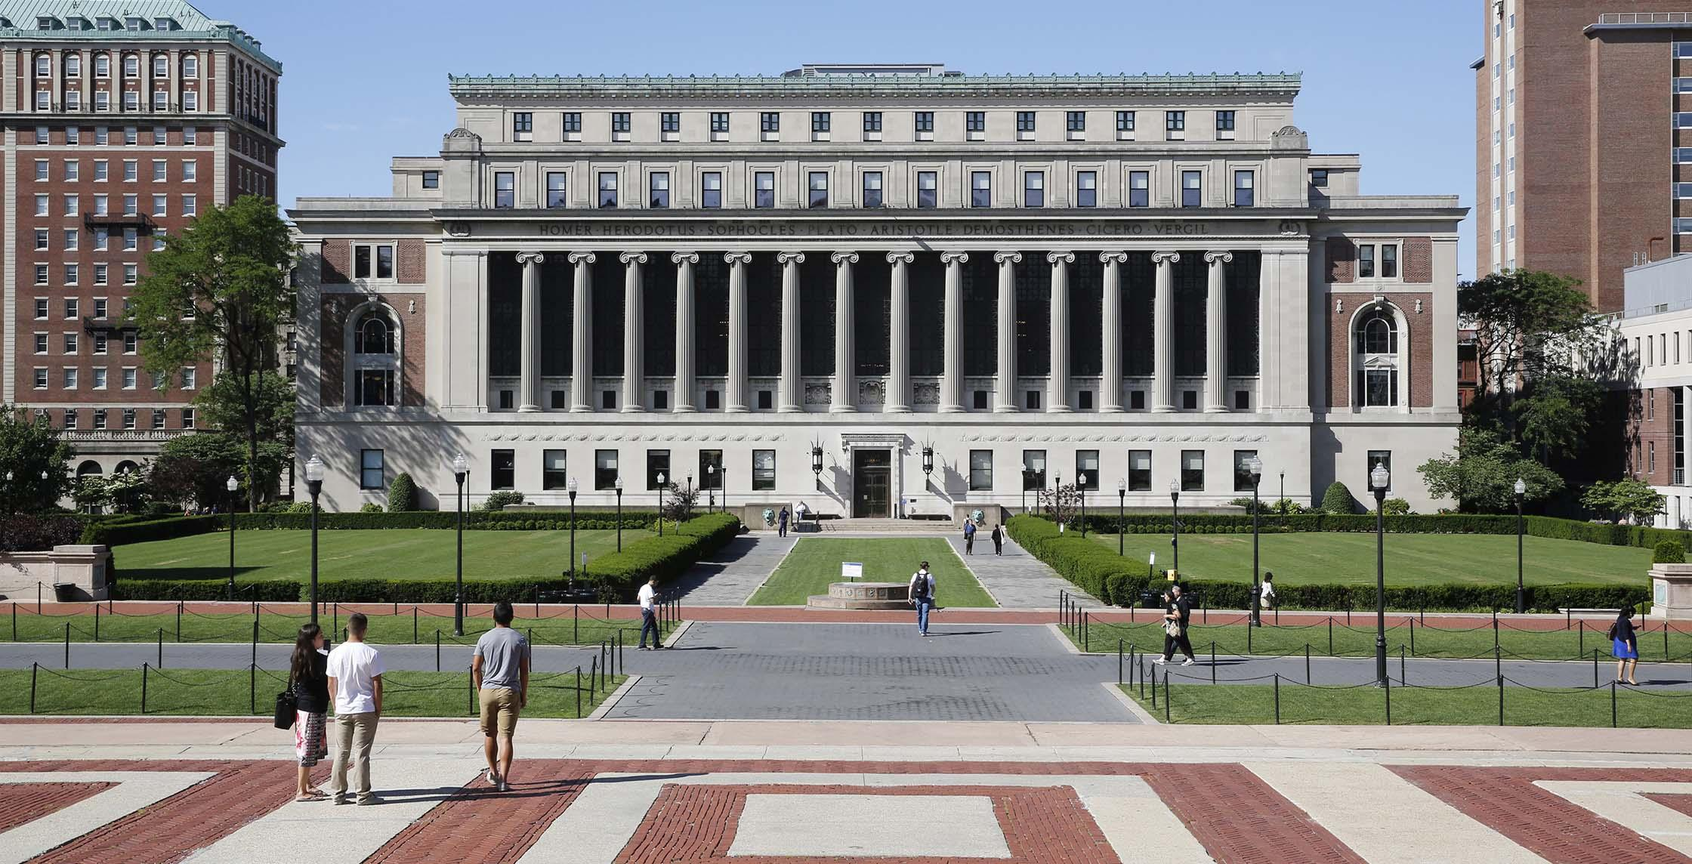
Conceptual Experience_1
Datamining the City Fall 2016
Ge Zhao, Jiaqi Sun, Tianyang Xie

Slide 21
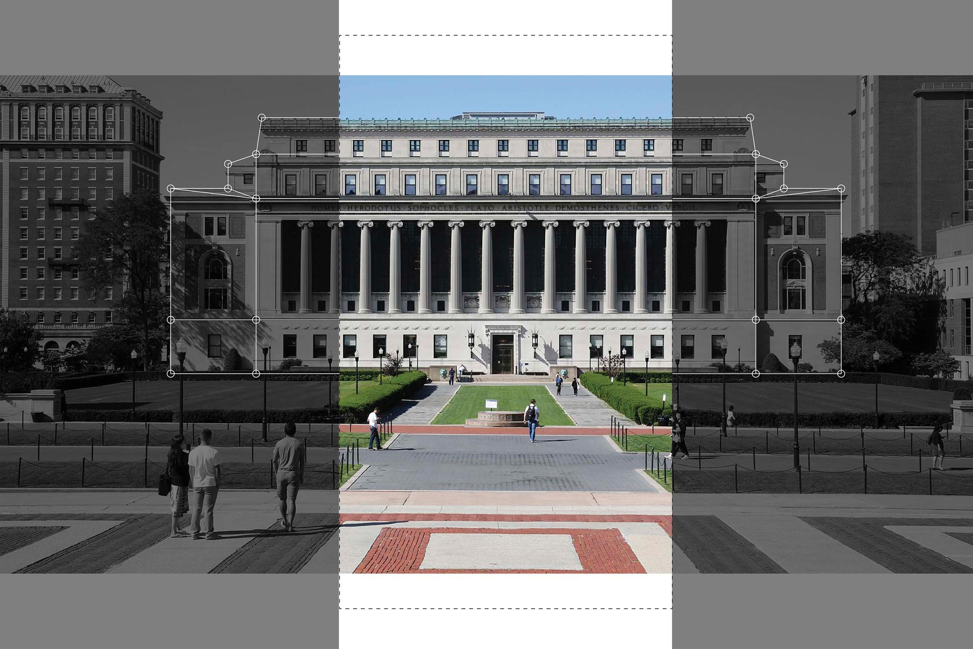
Recognize Building Shape
Datamining the City Fall 2016
Ge Zhao, Jiaqi Sun, Tianyang Xie

Slide 22
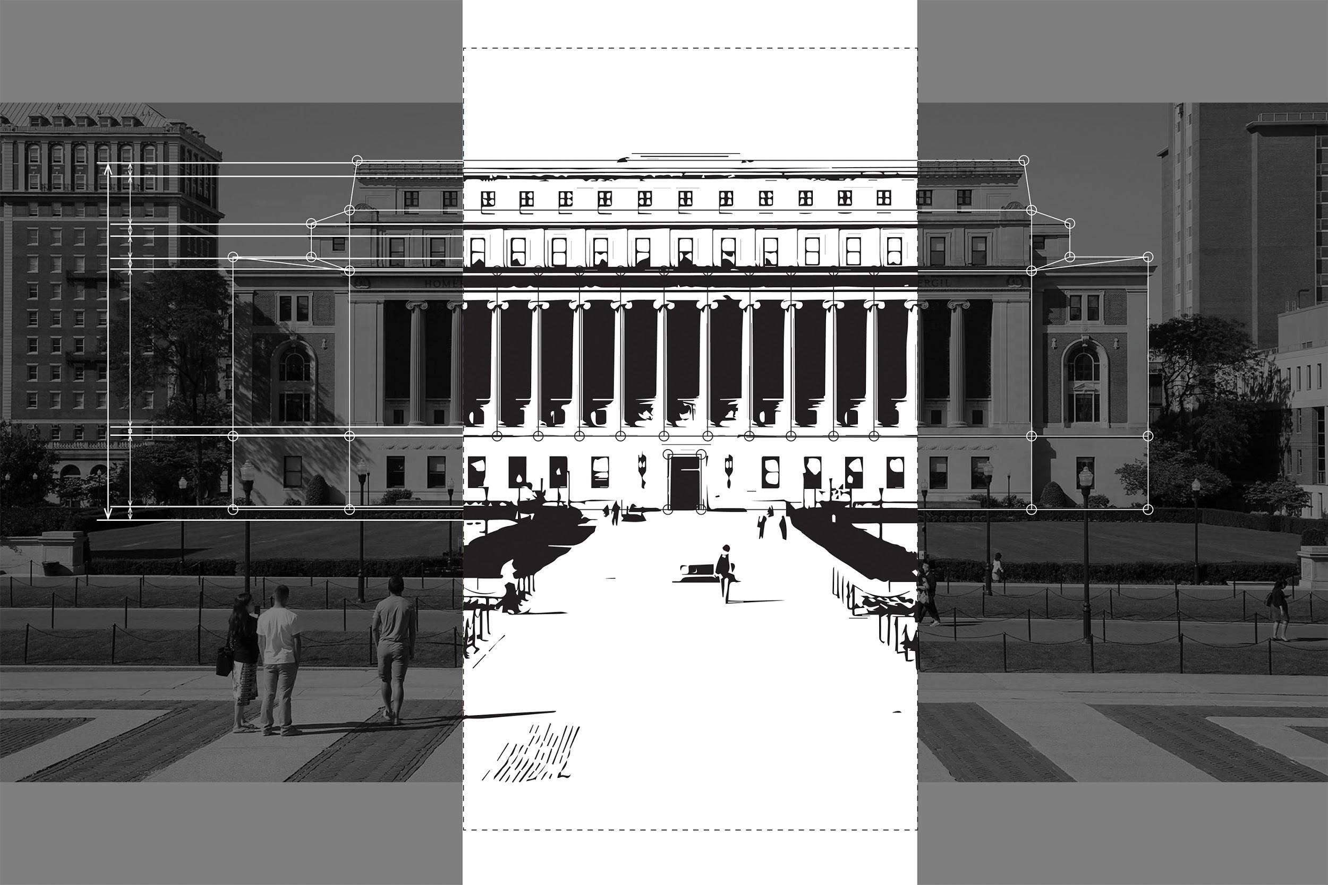
Modeling and Measuring
Datamining the City Fall 2016
Ge Zhao, Jiaqi Sun, Tianyang Xie

Slide 23
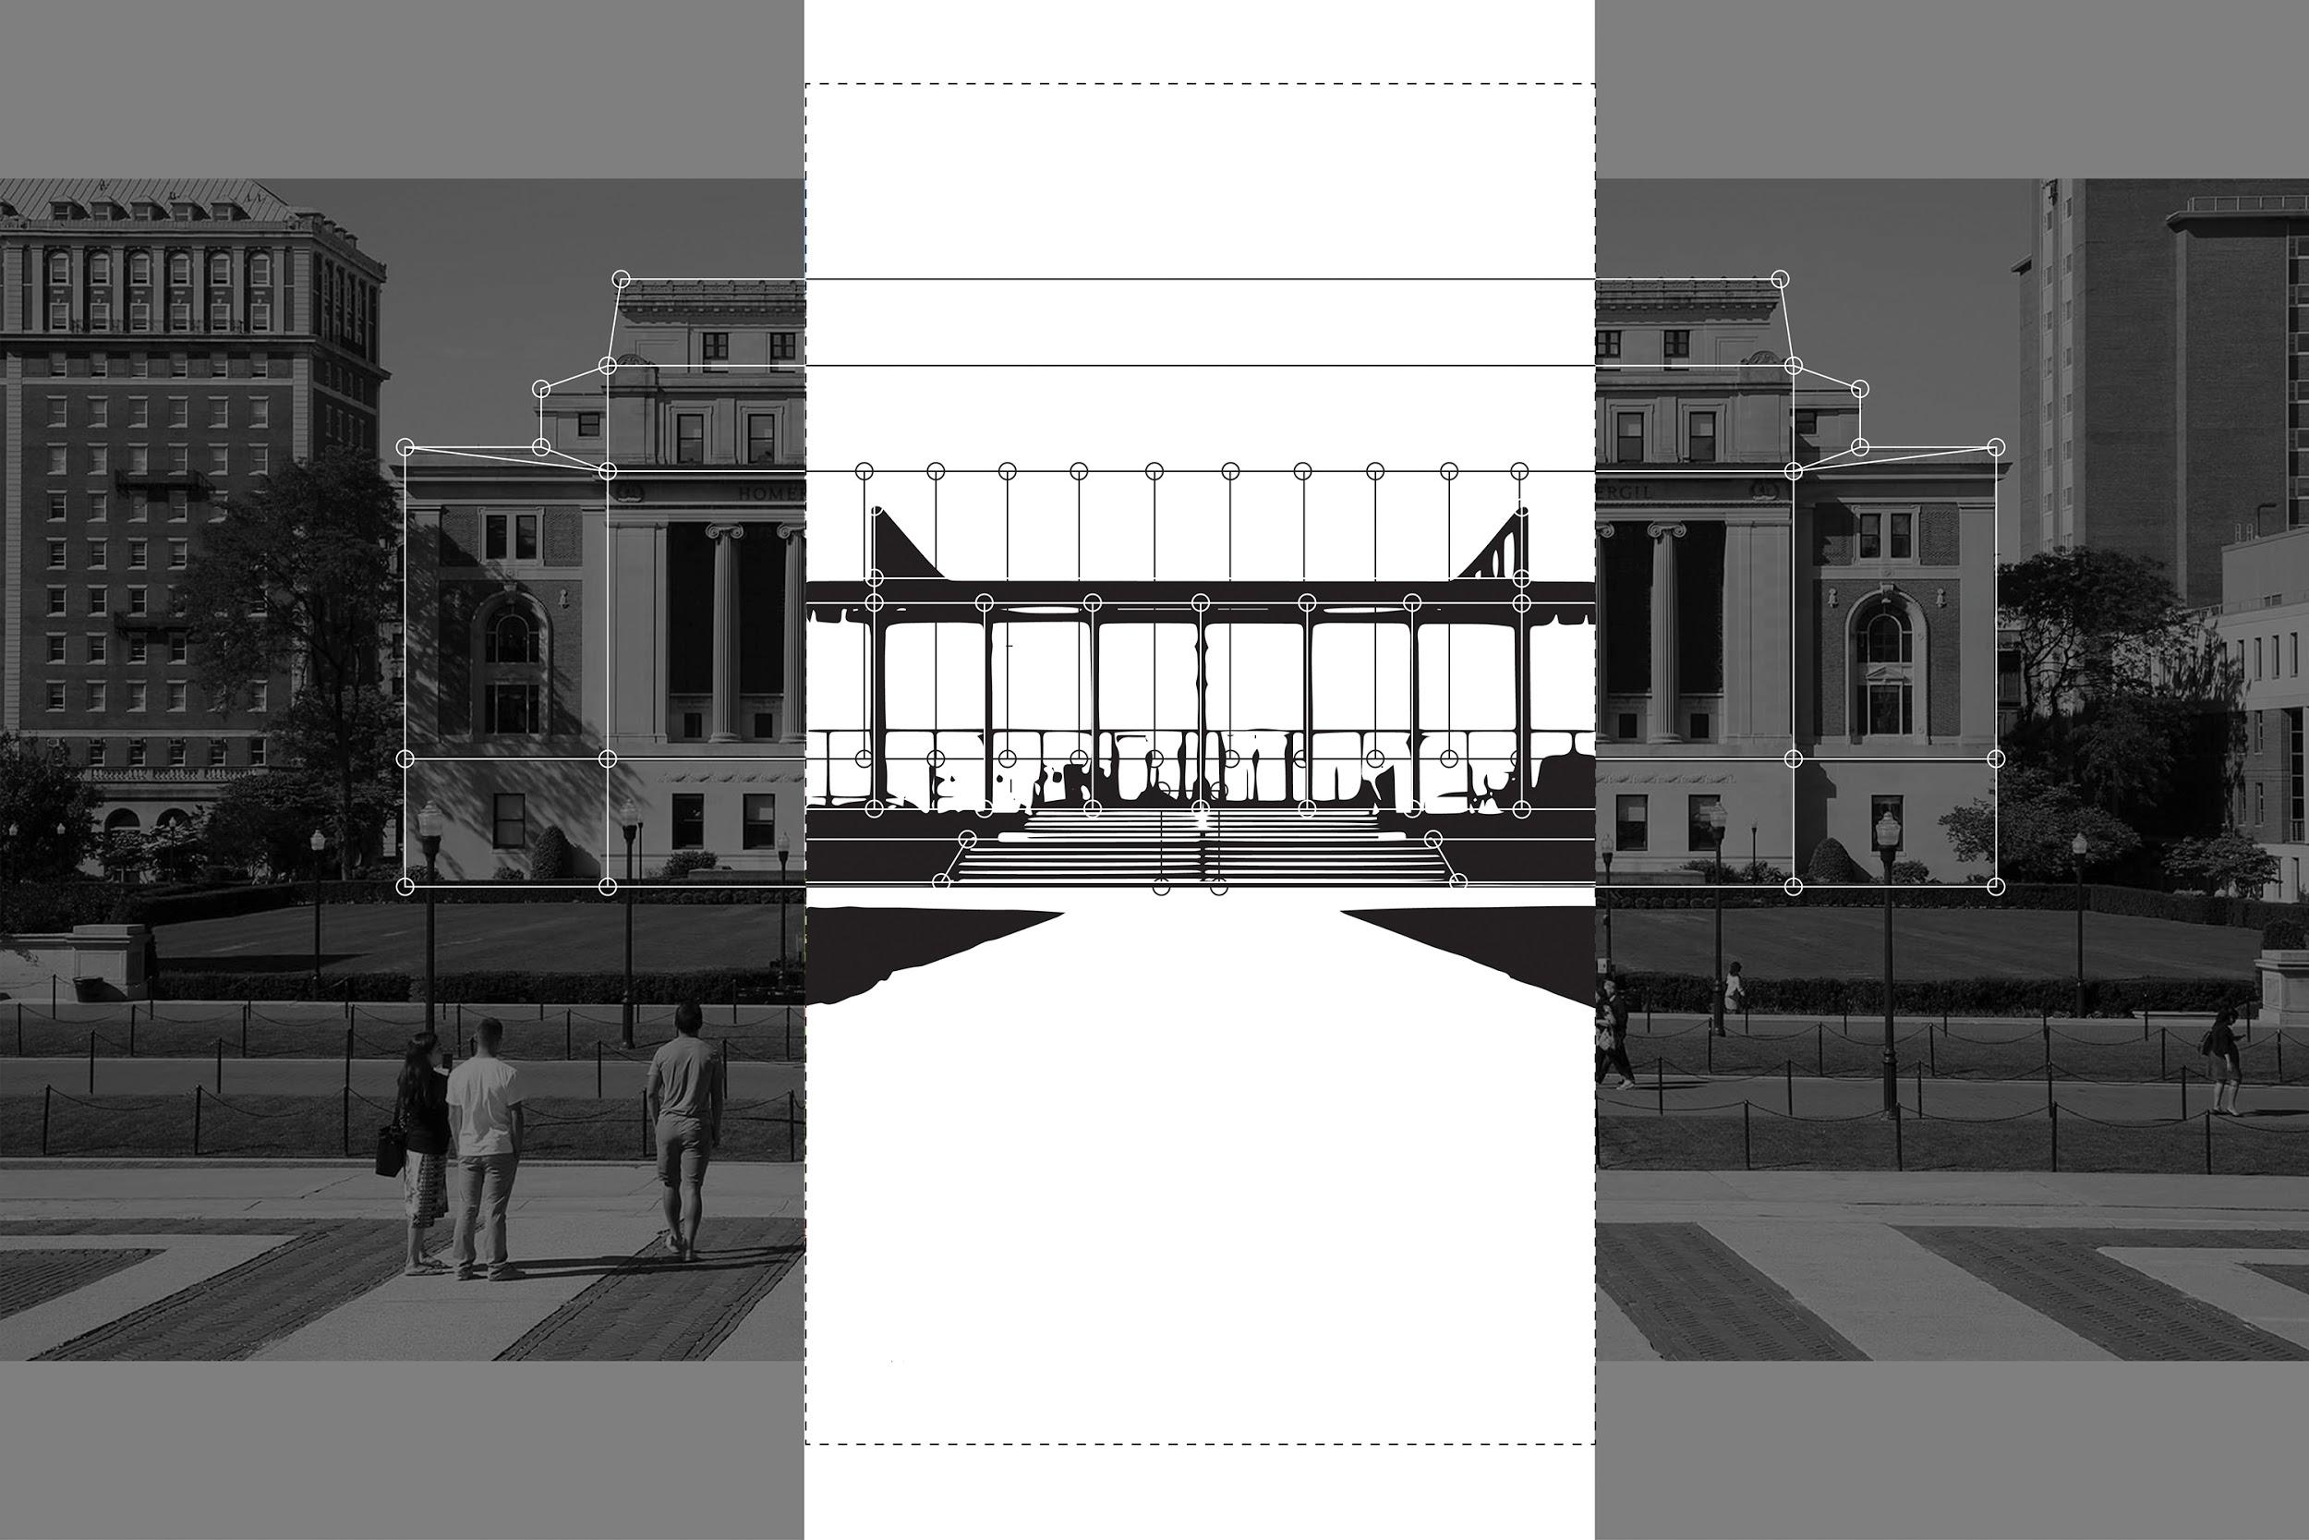
Structure Optimize
Datamining the City Fall 2016
Ge Zhao, Jiaqi Sun, Tianyang Xie

Slide 24
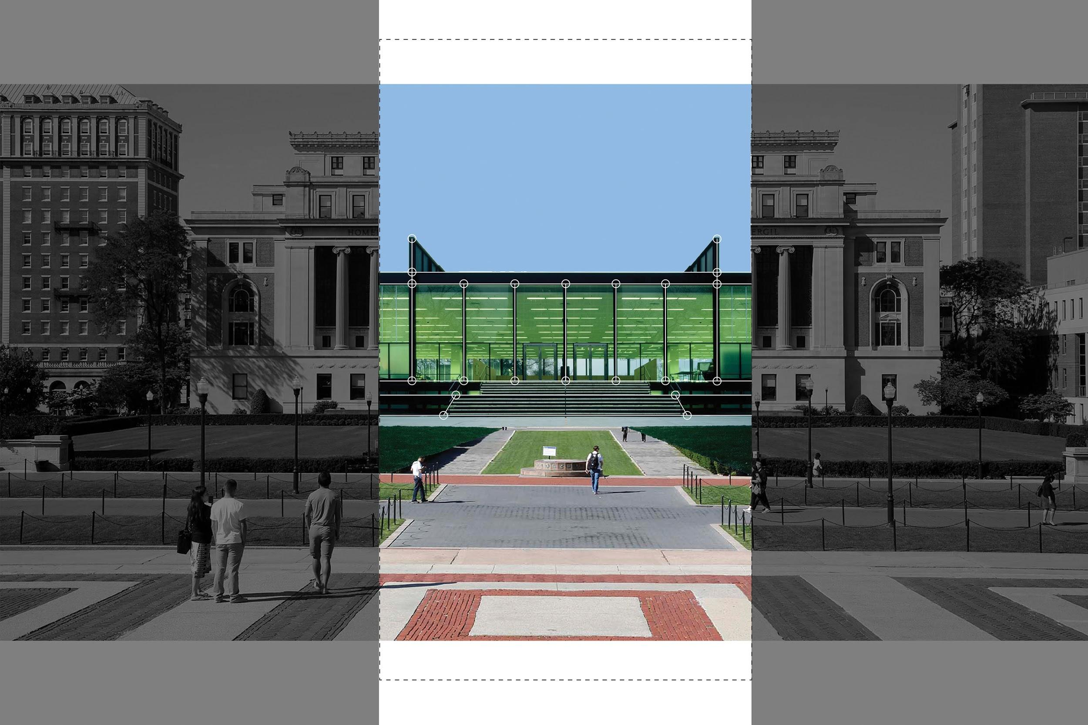
Generating New Form
Datamining the City Fall 2016
Ge Zhao, Jiaqi Sun, Tianyang Xie

Slide 25
Conceptual Experience_2
Datamining the City Fall 2016
Ge Zhao, Jiaqi Sun, Tianyang Xie

Slide 26
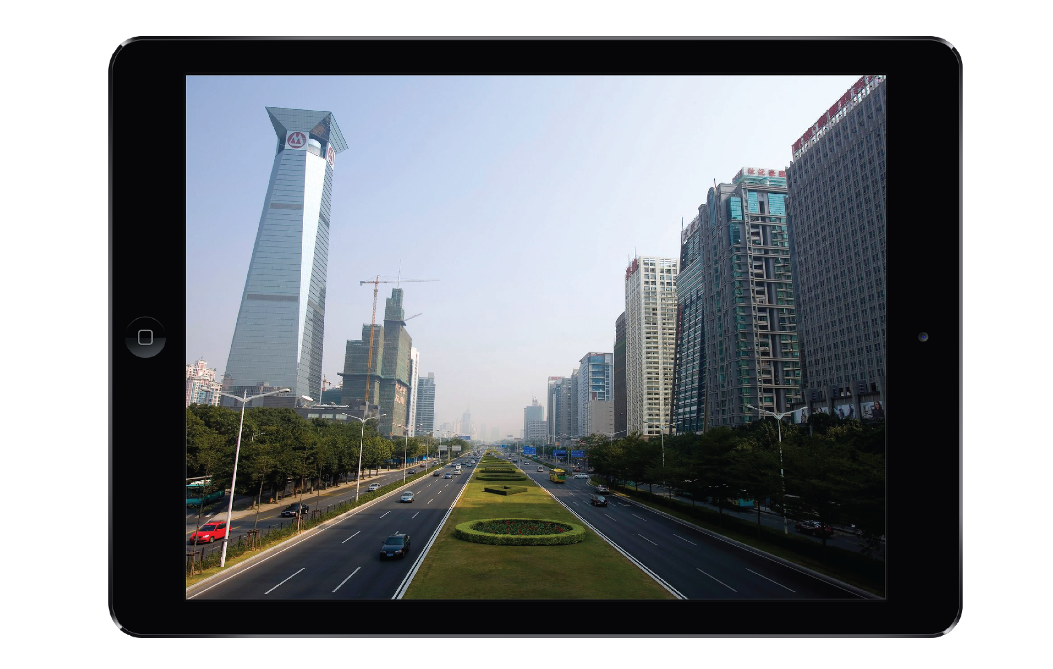
Conceptual Experience_2
Datamining the City Fall 2016
Ge Zhao, Jiaqi Sun, Tianyang Xie

Slide 27
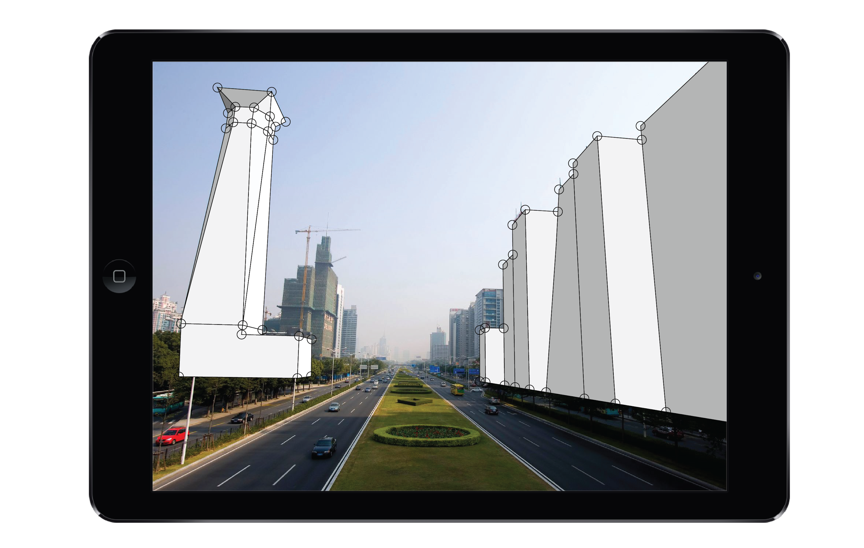
Conceptual Experience_2
Datamining the City Fall 2016
Ge Zhao, Jiaqi Sun, Tianyang Xie

Slide 28

Conceptual Experience_2
Datamining the City Fall 2016
Ge Zhao, Jiaqi Sun, Tianyang Xie

Slide 29
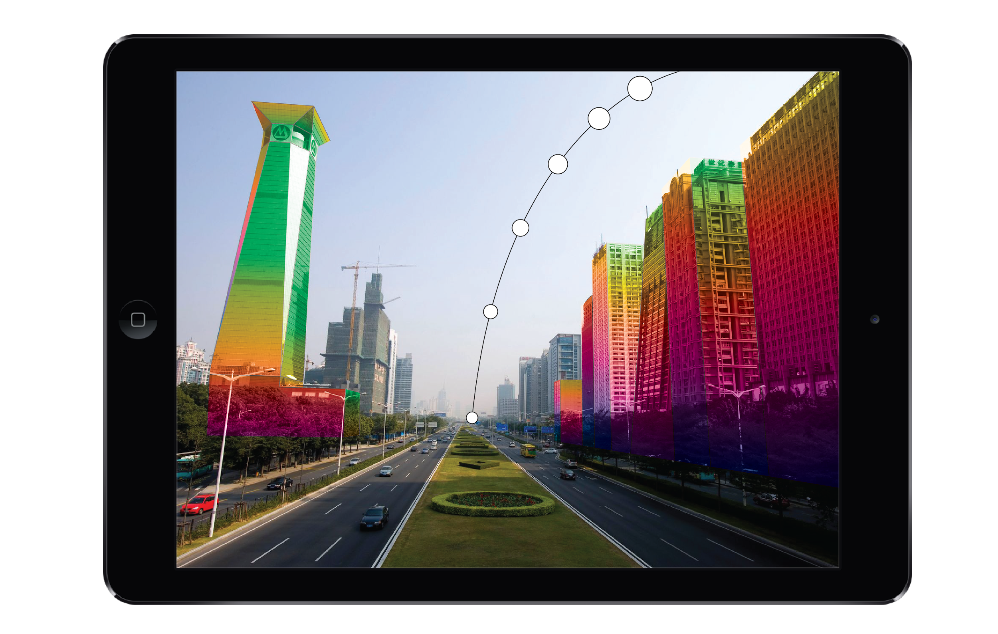
Conceptual Experience_2
Datamining the City Fall 2016
Ge Zhao, Jiaqi Sun, Tianyang Xie

Slide 30
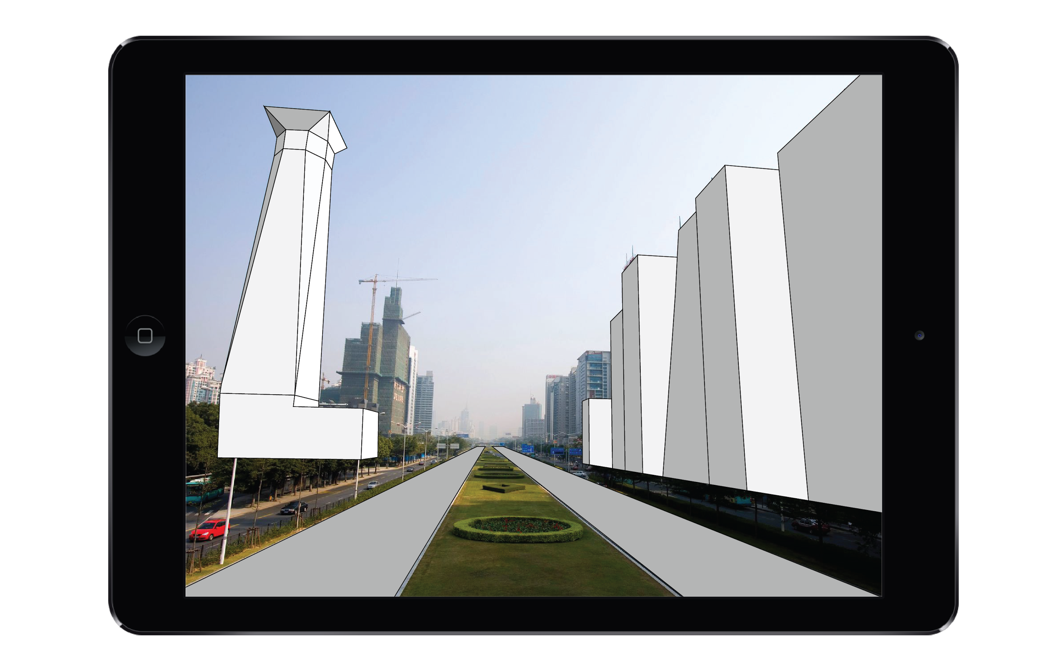
Conceptual Experience_2
Datamining the City Fall 2016
Ge Zhao, Jiaqi Sun, Tianyang Xie

Slide 31
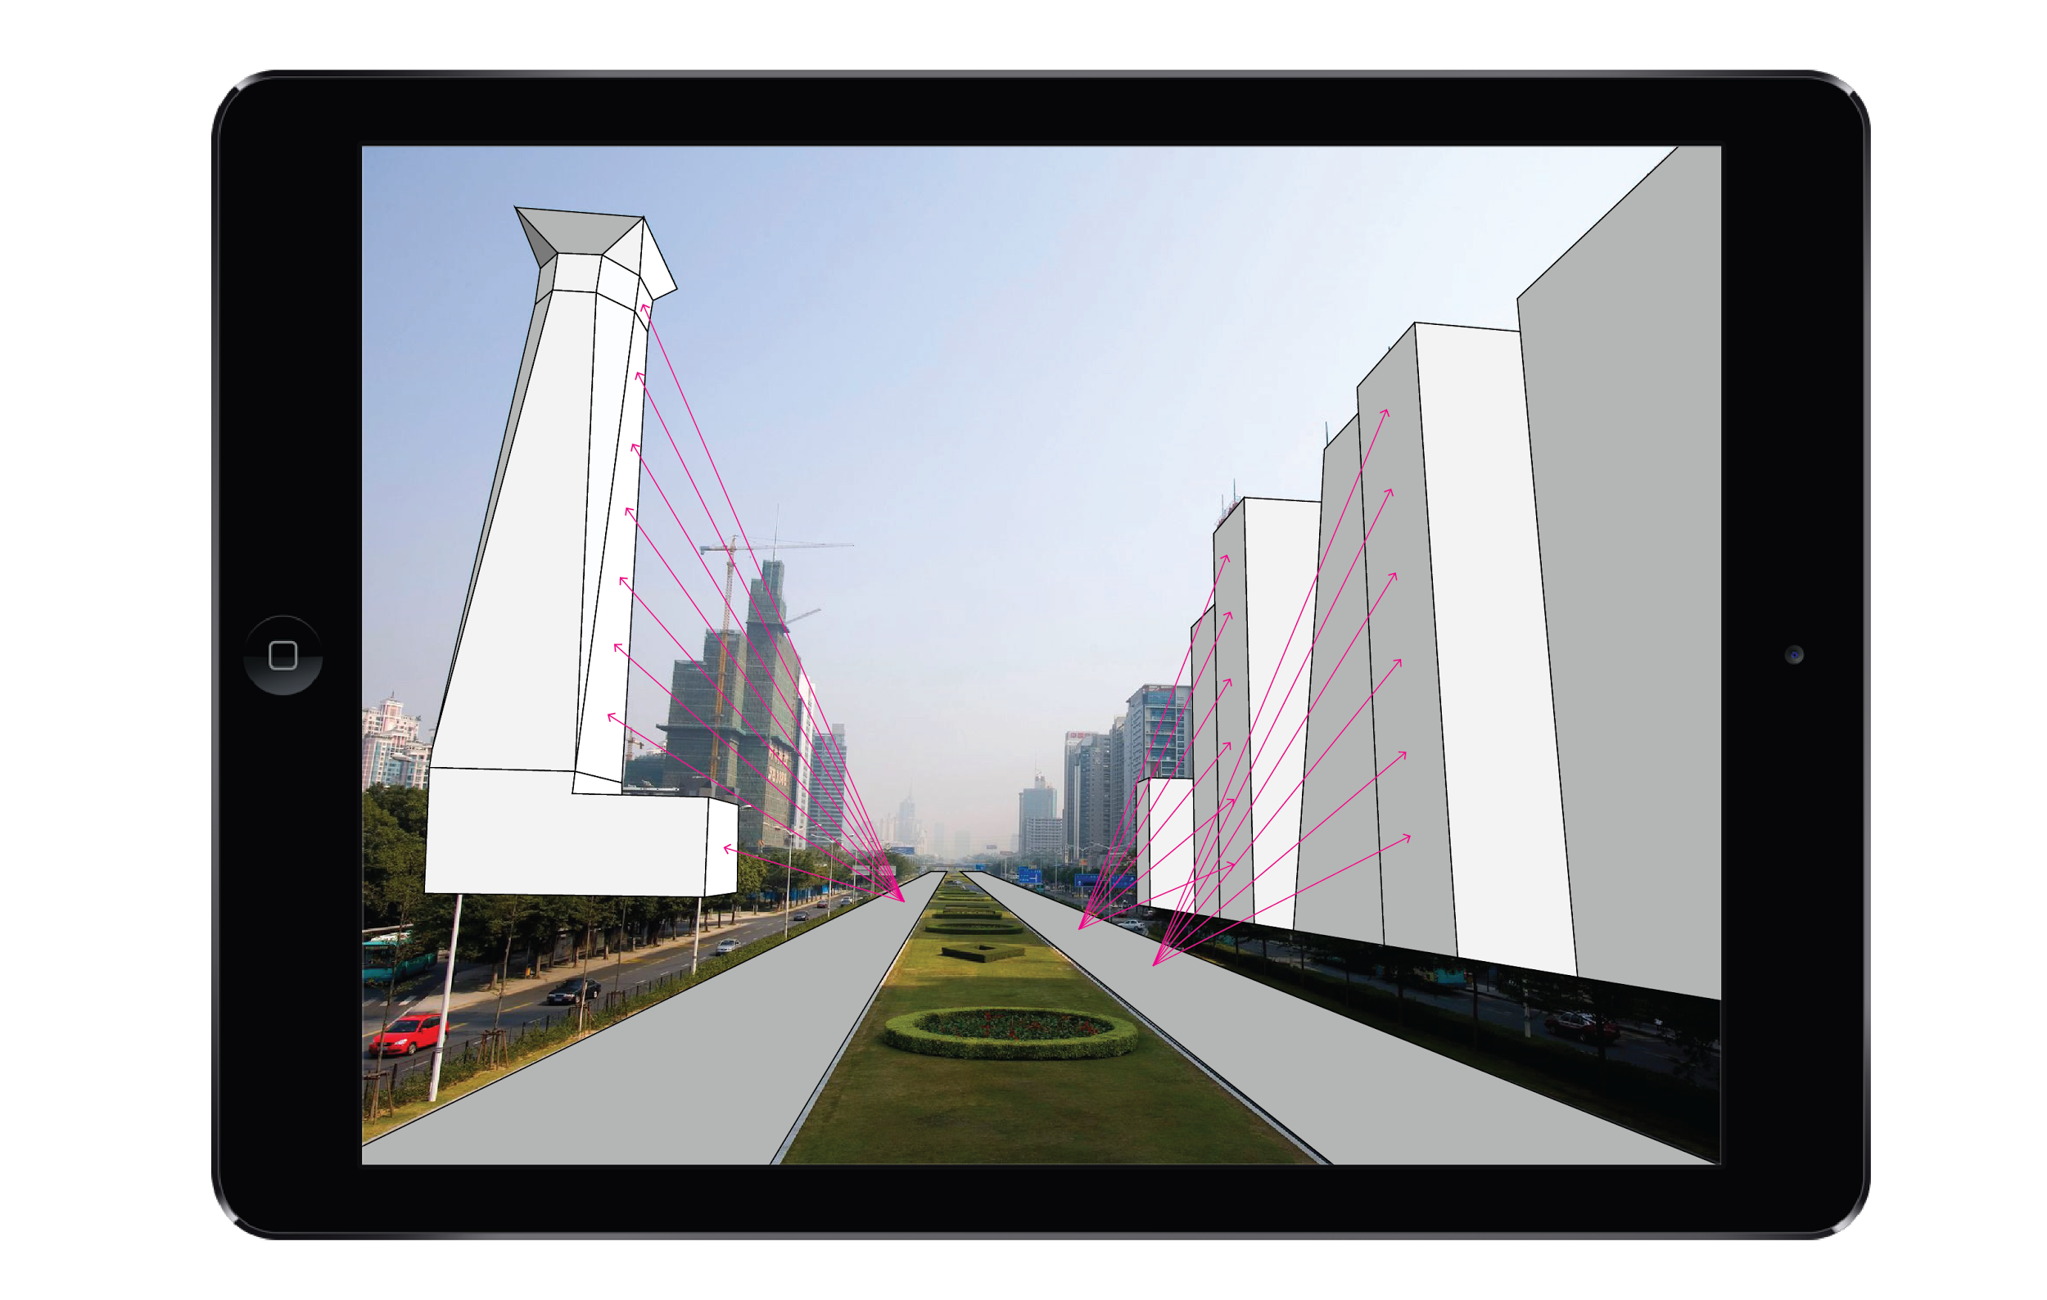
Conceptual Experience_2
Datamining the City Fall 2016
Ge Zhao, Jiaqi Sun, Tianyang Xie

Slide 32
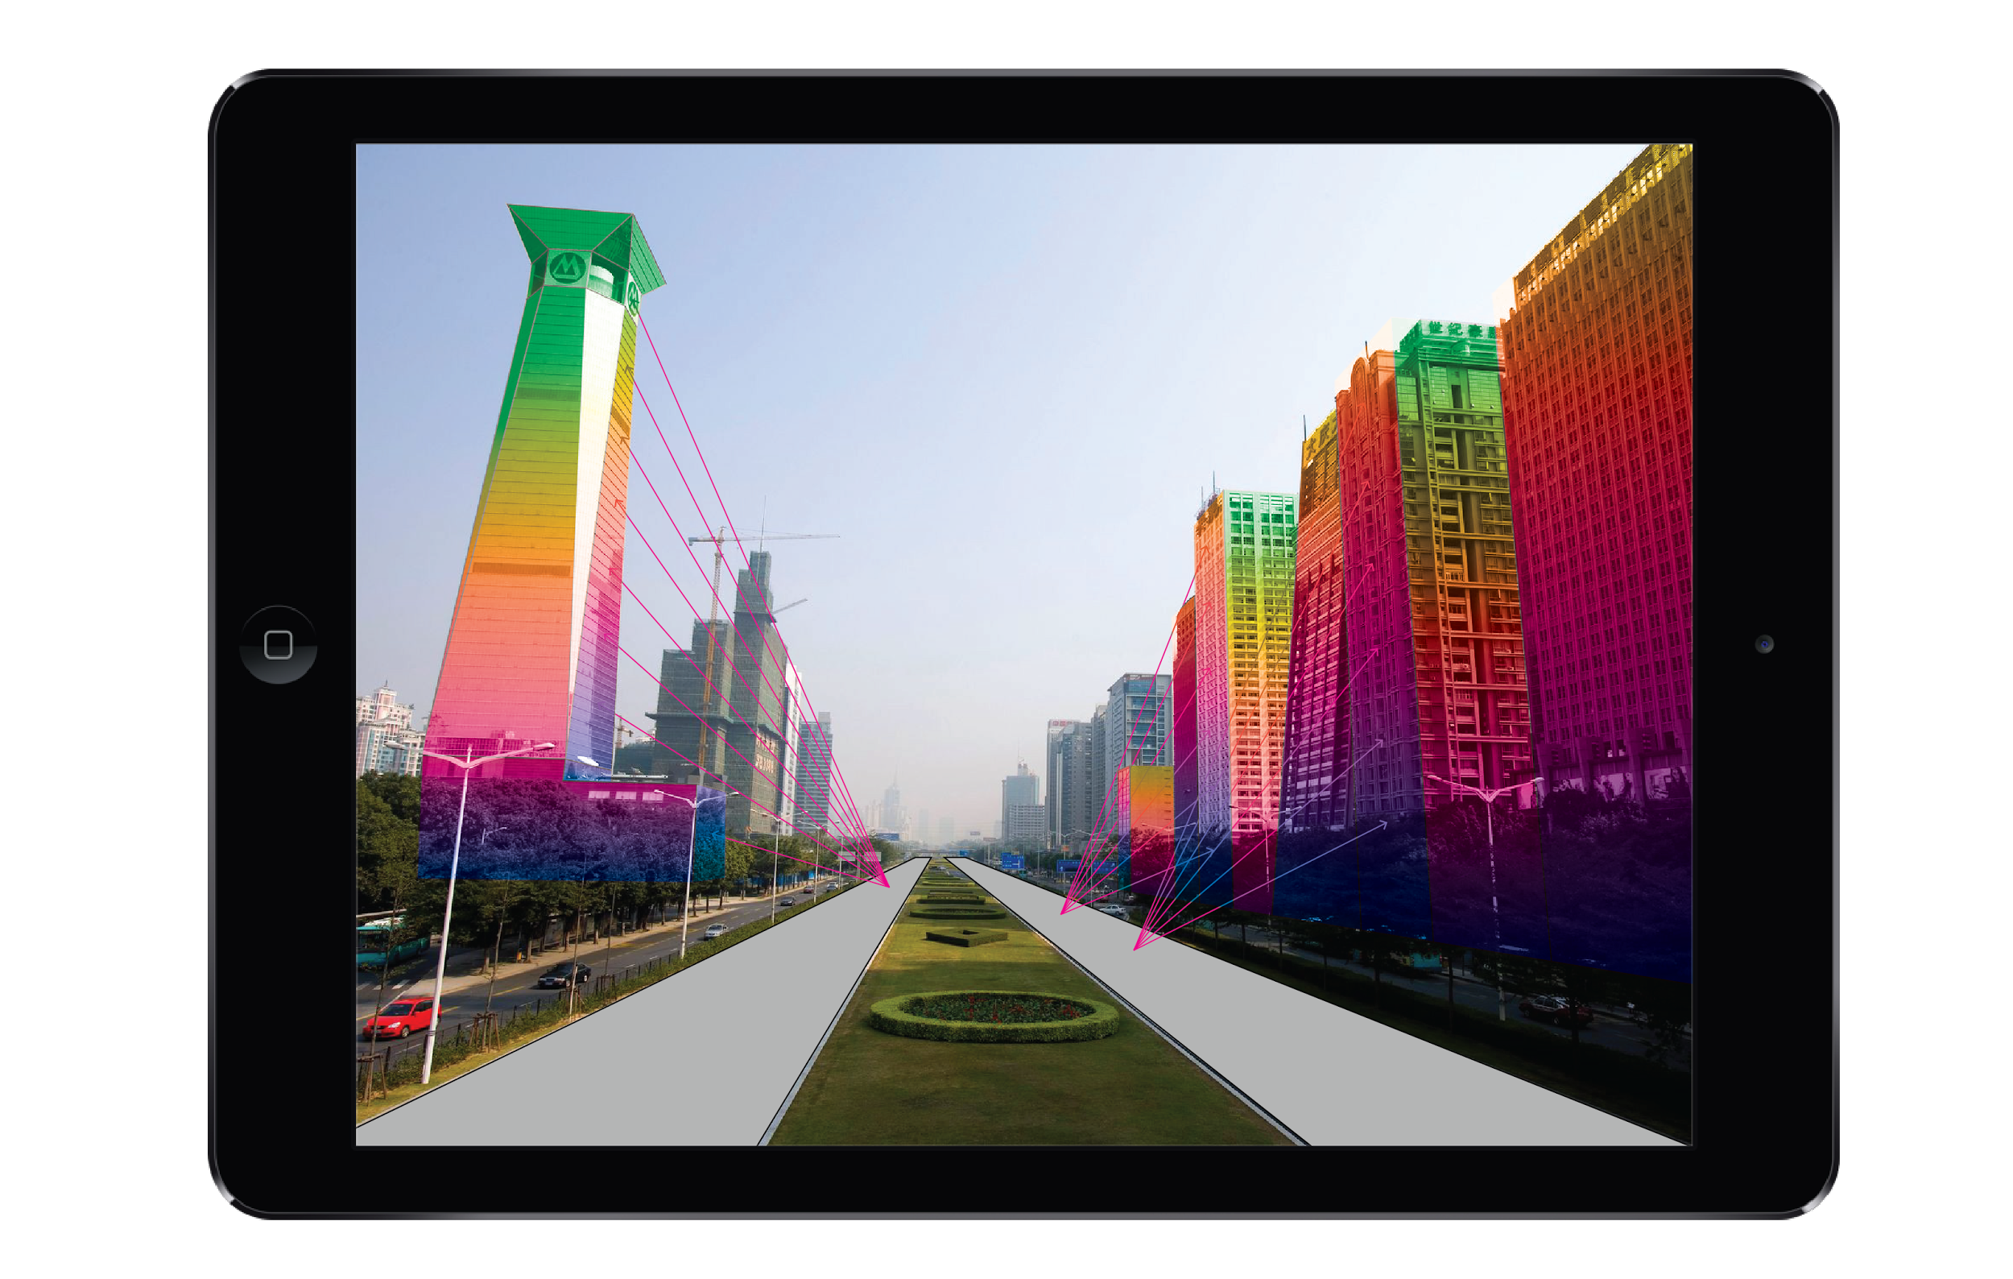
Conceptual Experience_2
Datamining the City Fall 2016
Ge Zhao, Jiaqi Sun, Tianyang Xie

Slide 33
Conceptual Experience_3
Datamining the City Fall 2016
Ge Zhao, Jiaqi Sun, Tianyang Xie

Slide 34
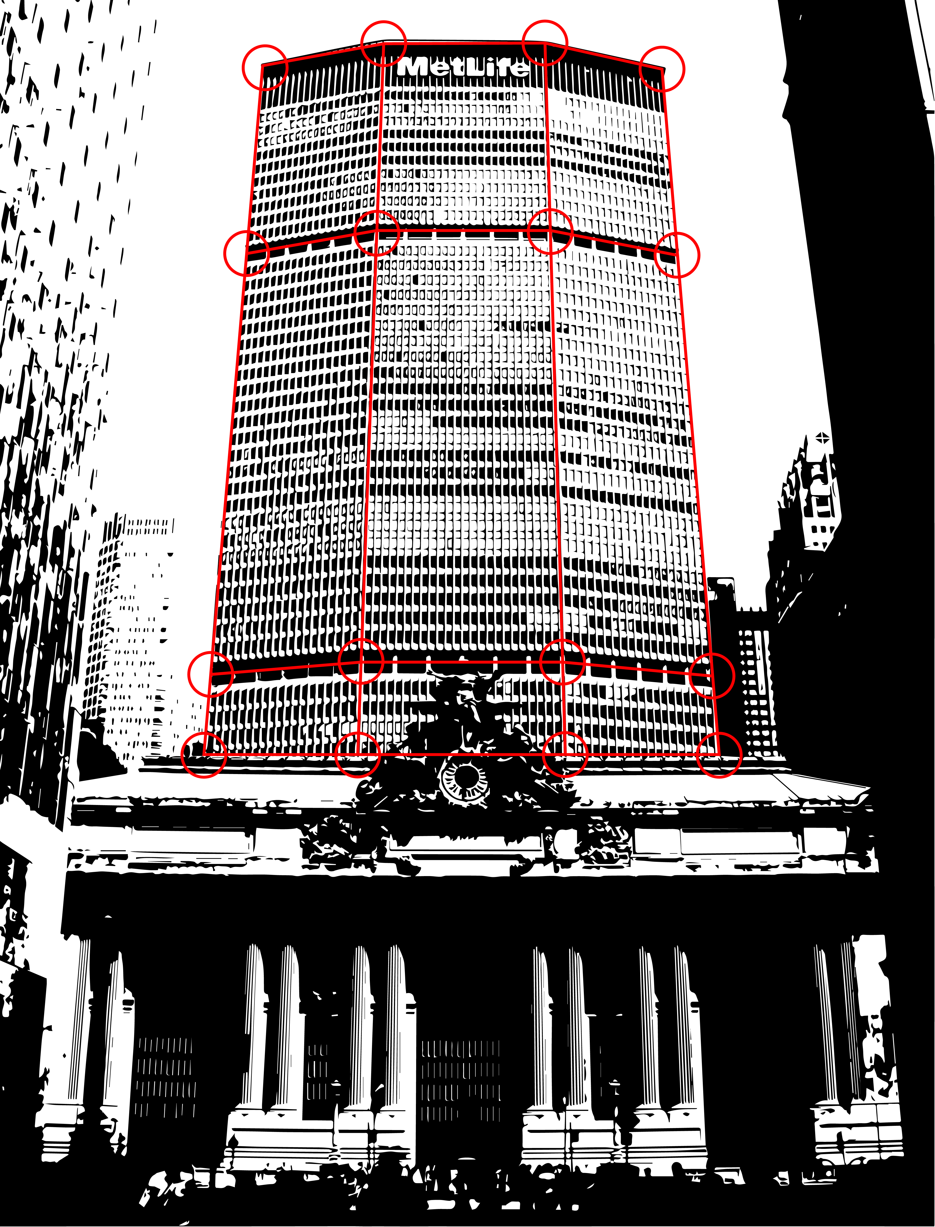
Conceptual Experience_3
Datamining the City Fall 2016
Ge Zhao, Jiaqi Sun, Tianyang Xie

Slide 35
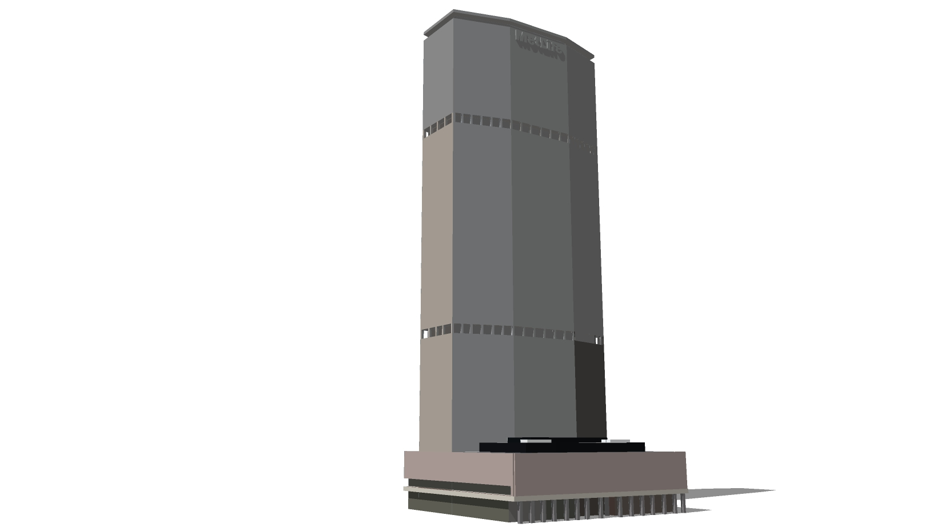
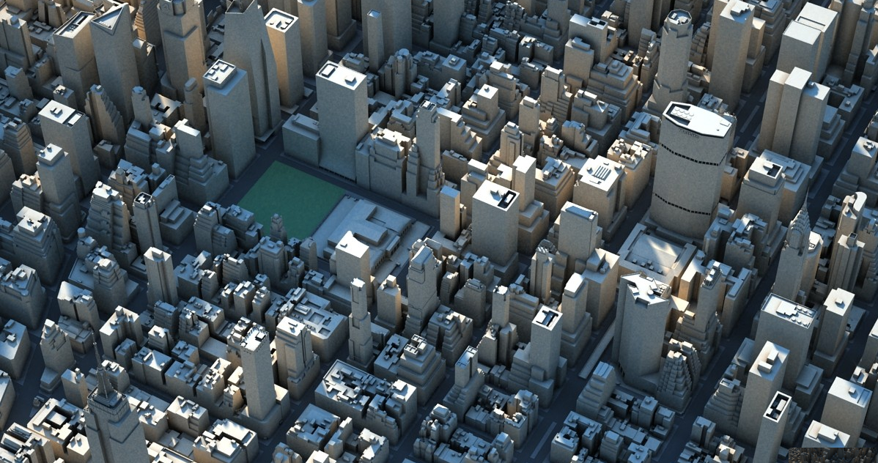
Conceptual Experience_3
Model
View Point
GPS Data
Datamining the City Fall 2016
Ge Zhao, Jiaqi Sun, Tianyang Xie

Slide 36
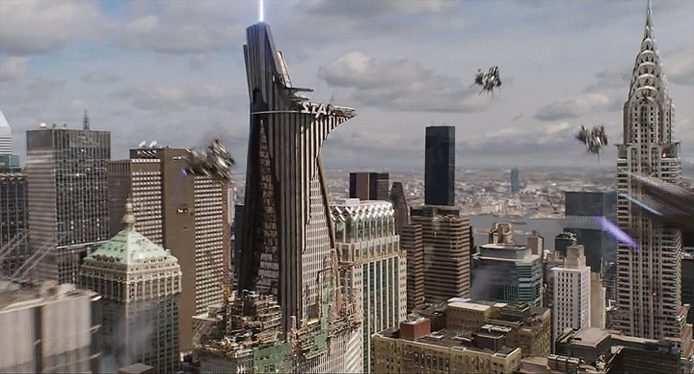
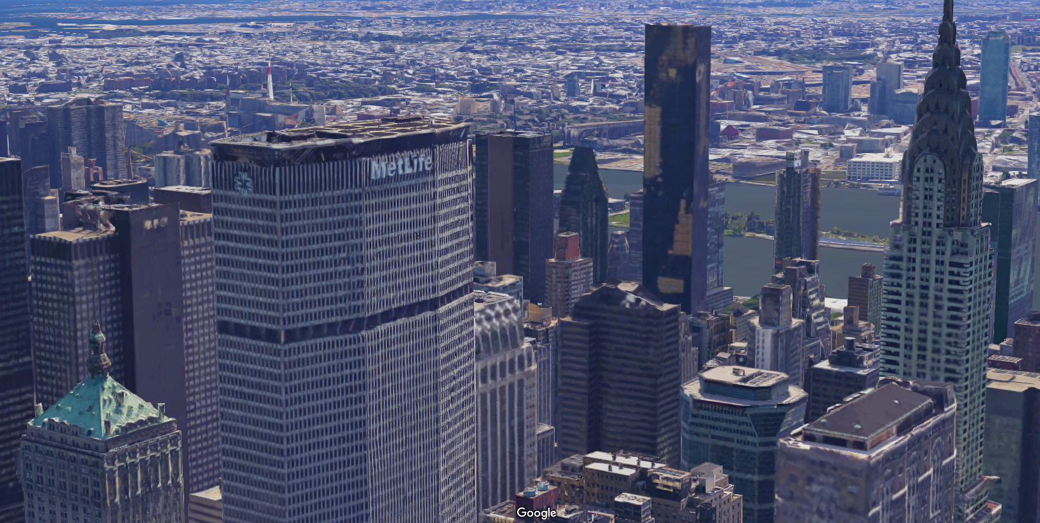
Conceptual Experience_3
Screenshot of Avengers 2
Screenshot of Google Map
Datamining the City Fall 2016
Ge Zhao, Jiaqi Sun, Tianyang Xie

Slide 37
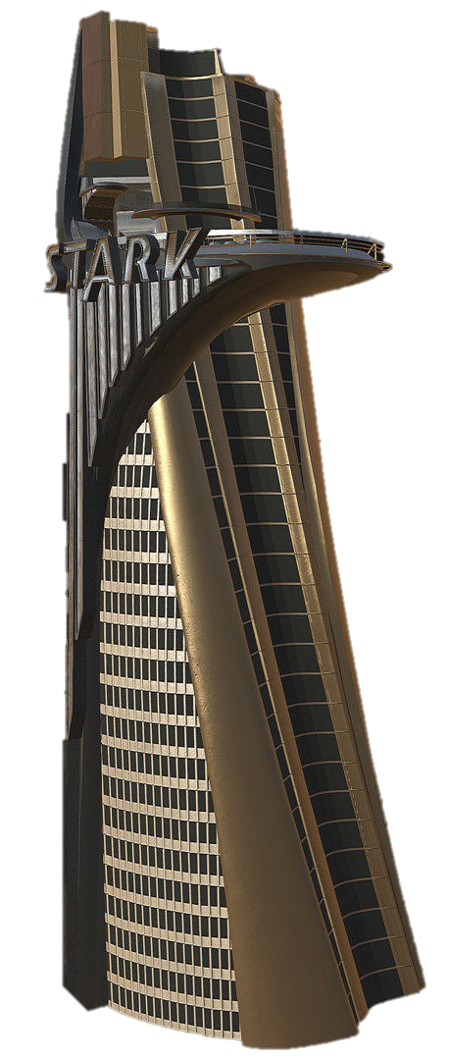
Conceptual Experience_3
Datamining the City Fall 2016
Ge Zhao, Jiaqi Sun, Tianyang Xie

Slide 38
Conceptual Experience_3
Datamining the City Fall 2016
Ge Zhao, Jiaqi Sun, Tianyang Xie

Slide 39
#Thank_You!
Datamining the City Fall 2016
Ge Zhao, Jiaqi Sun, Tianyang Xie

